Slide 1

Class 2
What is literature?
Life-writing
Webcomics
Graphic narrative
Popular read
Allie Brosh
Blogger
Cartoonist
Autobiographer

Slide 2
What is literature?
Our Storied Worlds | To narrativize To imagine
The particular “institution” of literature | production circulation reading practices

Slide 3
The Case of Allie Brosh’s Hyperbole and a Half
first appeared on Blogspot platform in 2009
later Tumblr, YouTube, and Facebook
The chequered history of the “popular”,
of emergent forms & genres

Slide 4
Why read literature?
What is the “use”?
The Usefulness of Literature The Uselessness of Literature

Slide 5
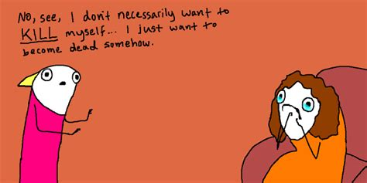
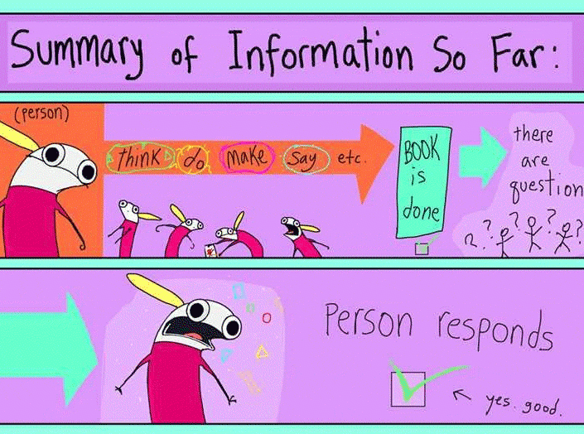
Mental illness narrative
Challenging stereotypes
Attention to emergent forms & genres
Quirky
Funny
“time-pass”

Slide 6
Why read literature?
Why study literature?
Difference between amateur reading & analytical reading | Not “appreciation” Not summary/paraphrase/review

Slide 7
What is to interpret & analyse literature?
how language PRODUCES meaning how the stories we tell shape “reality” how interpretations are multiple how form constitutes meanings how to contextualize a text how cultures shape and are shaped by literature

Slide 8
Today in class
Class 3
Analyzing
Form-Genre (& Media)
i. Structure
ii. Histories/Lineages
2
Close Textual Reading
3
A quick Recap
1

Slide 9
Form, Genre, Media
FORM | GENRE | MEDIA
Novel Non-fiction Novella Essay Poetry Prose Short Story Drama | Fantasy Science Fiction Mystery Thriller Biography Autobiography Romance Realist | Oral Print Digital Performance
The Case of Hyperbole and a Half
Hybrid form, new evolving forms-genres, new mobilities
1. Visual-verbal: Comics counter-culture (“Underground comix” 1960s-70s)
2. Life-Writing/Autobiography

Slide 10
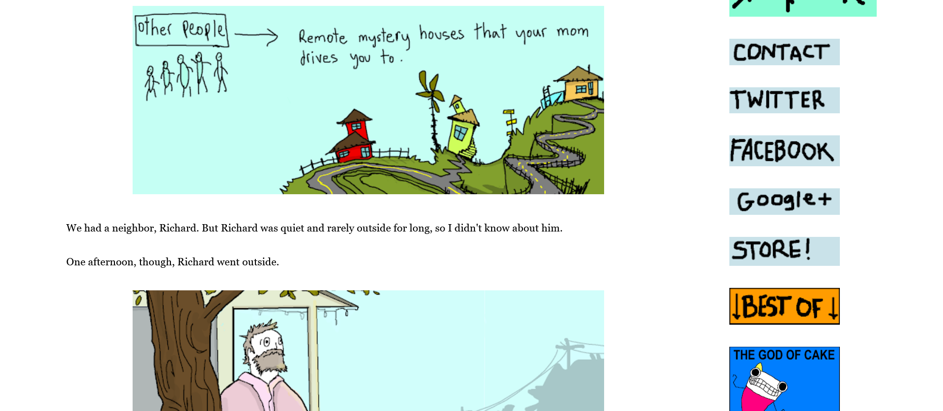
1. Form, Genre, Media
As Web comics/Blog
https://hyperboleandahalf.blogspot.com/

Slide 11
1. Form, Genre, Media
social media
featured posts
dated entries
archive of previous works
followers
Contemporary Digital Cultures: New impulses
Immediacy
“Transparency”—(the personal is public?)
“W/Reading” online

Slide 12


1. Form, Genre, Media

Slide 13
As (printed) Book
The (different) Idea of
Organisation:
Beginning-Middle-End
“Depth”/ close attention
What you can/not see
The call to intuit/interpret
find patterns
probe words, images, structures, connotations
the “power” of form, genre, media
1. Form, Genre, Media

Slide 14
Attending to
“adaptation” [of webcomics to book]
visual-verbal metaphors & other literary devices
the child-like style

Slide 15
Today in class
Class 4
The Case of Hyperbole and a Half
Hybrid form, evolving genres, new mobilities
Visual-verbal: Comics
Life-Writing/Autobiography
Analyzing
Form-Genre (& Media)
i. Structure
ii. Histories/Lineages
1
Close Textual Reading
2

Slide 16
1. Form, Genre, Media
As Webcomics/Blog
https://hyperboleandahalf.blogspot.com/
Contemporary Digital Cultures: New impulses
& Aesthetics
Immediacy
“Transparency”—(the personal is public?)
“W/Reading” as online activity

Slide 17
As (printed) Book
The (different) Idea of
Organisation:
Beginning-Middle-End
The call to intuit/interpret
“Depth”/ close attention
What you can/not see
1. Form, Genre, Media

Slide 18
the “power” of form, genre, media

Slide 19
Close Textual Reading
to probe words, images, structures, connotations
to examine form, structure
to find patterns
visual-verbal metaphors & other literary devices
style (child-like? deliberately non-artistic?)

Slide 20
Form, Genre, Media
The Case of Hyperbole and a Half
Hybrid form, new evolving form
1. Visual-verbal: Comics and counter-culture (1960s-70s)
2. Life-writing/Autobiography

Slide 21
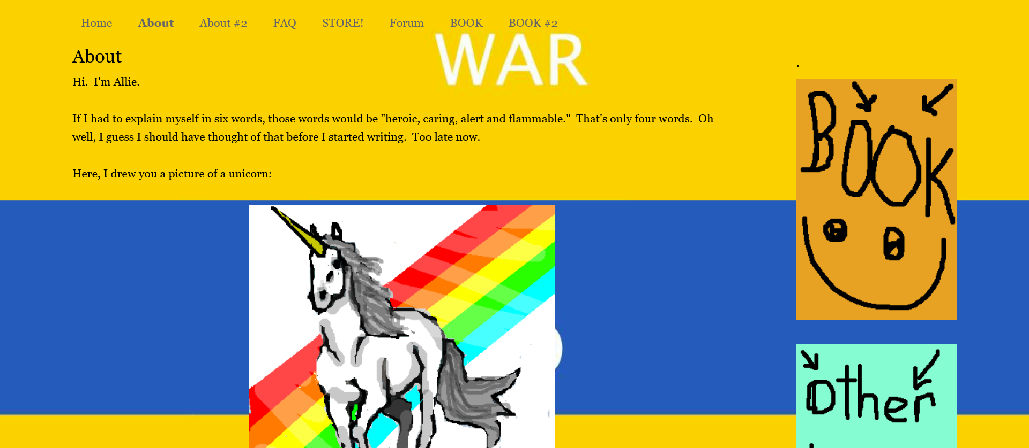

Slide 22
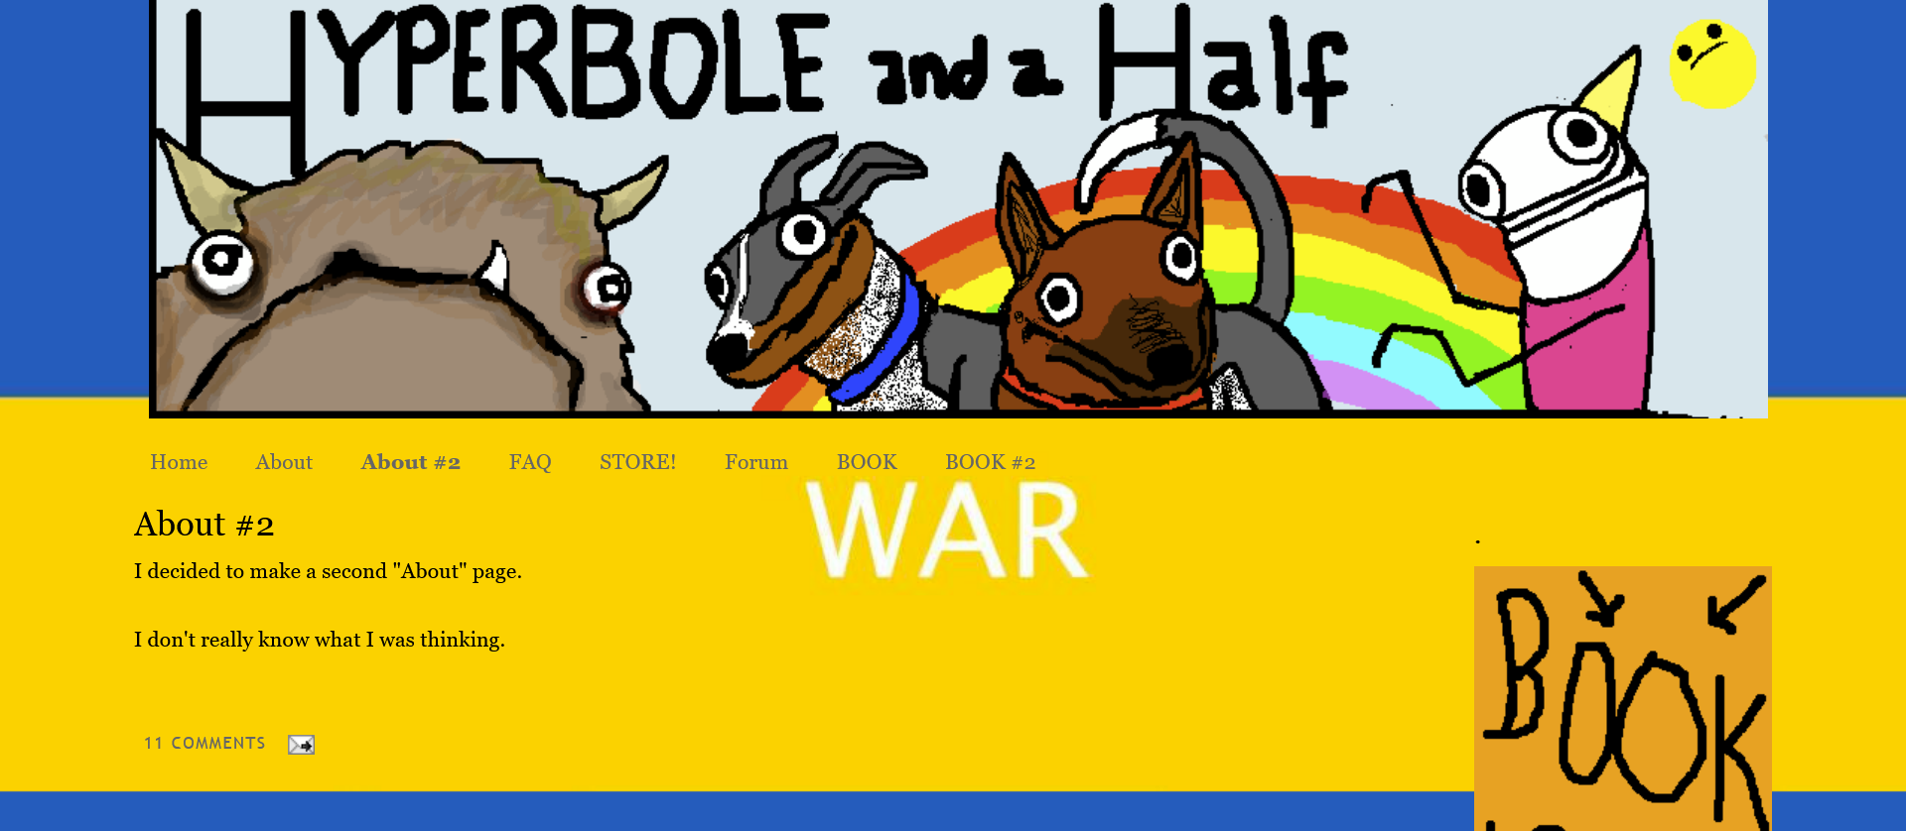

Slide 23
Autobiography Biography Memoir Personal Narratives Testimonios
Histories/Lineages of the Genre
A life re-shaped in writing through recollections
The Emergence of Autobiography
An early eg: Saint Augustine’s Confessions (400)
Invention of the individual
Historically
Philosophically Identity
self-sameness-
as different from others

Slide 24
Autobiographies of the “Insignificant” Autobiographies: Artless ART-ifacts?
Writing life as conferring “significance”
Makes space for hidden, “invisiblized” lives in the imagination of the social
Negotiates historical absence
Aesthetic, political, ethical

Slide 25
Class 5
Close Textual Reading
Verbal-Visual
The 2 “I”-s in Autobiographies:
The Narrator and the Protagonist

Slide 26
The Verbal-Visual
The Reader in the Text
How does the current self “know” the past (10-years old) self?

Slide 28
Comic—use of absurdity, exaggeration
Two selves

Slide 29
Detour:
From “Depression Part 1”
(see recommended reading)
From “Depression Part 2”
Multiple & divided selves

Slide 30
Back to “Warning Signs”
Divided selves
Layered narration
Textual Strategies
Nested genres
Embedded Letters (Epistolary)
The Episodic as structure
Careless-squiggly style

Slide 31
“Warning Signs”
Pedagogic (Teacherly) tone
Dis/continuous self/selves

Slide 33
Tone?

Slide 35
Inventing modes of representation (verbal-visual) for:
the subliminal; that which is unsayable
complicated emotional & cognitive predicaments
fractured selves

